Slide 1
E-book Online Shopping System
Group Members:
1. Muhammad Nur Aqmal bin Khatiman 1712719
2. Luqman bin Mohammad 1714425
3. Ahmad Zaidan bin Adnan 1718733
4. Muhammad Salikin bin Ismail 1711083
5. Mohd Syafiq Asyraf bin Samsudin 1715447

Slide 2
Member’s Role
Akmal – Manager
Luqman –
Syafiq –
Zaidan –
Salikin –

Slide 3
Objective
To encourage the reading habit especially among students.
To help the students to get their books online
As the book in form of e-book, it is easier for student to bring it anywhere

Slide 4
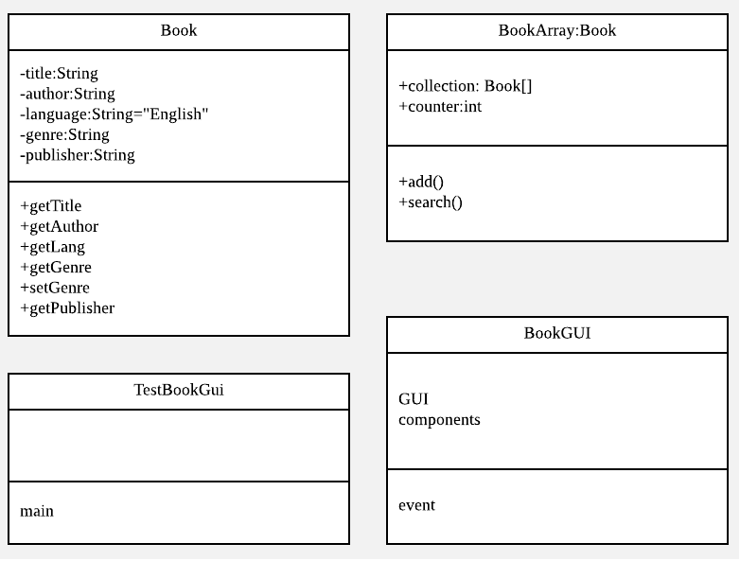
Uml Diagram

